Slide 1

An Introduction to my Text Mining Project on Zhu Fan Zhi诸蕃志
Jiating Liu

Slide 2

Contents
Part 1: The story I want to share with you
Part 2: The four iterations of my project
Part 3: The future plans of my project

Slide 3
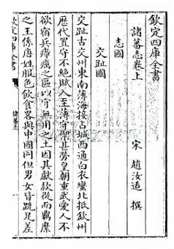
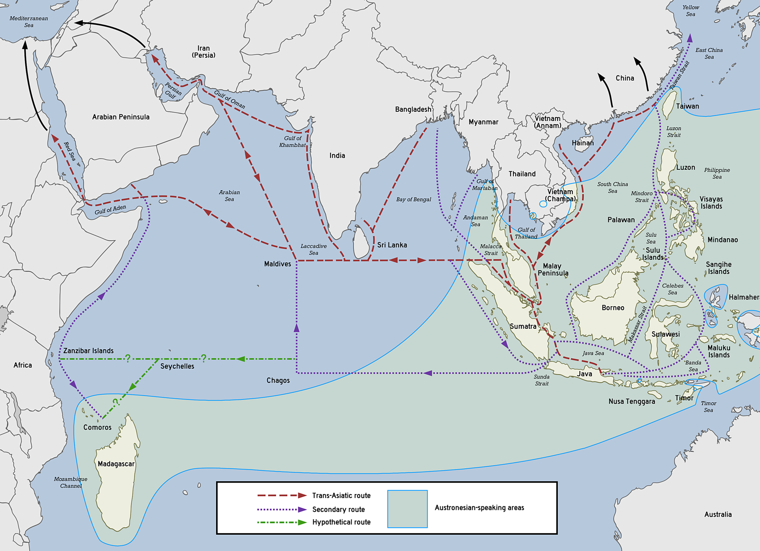
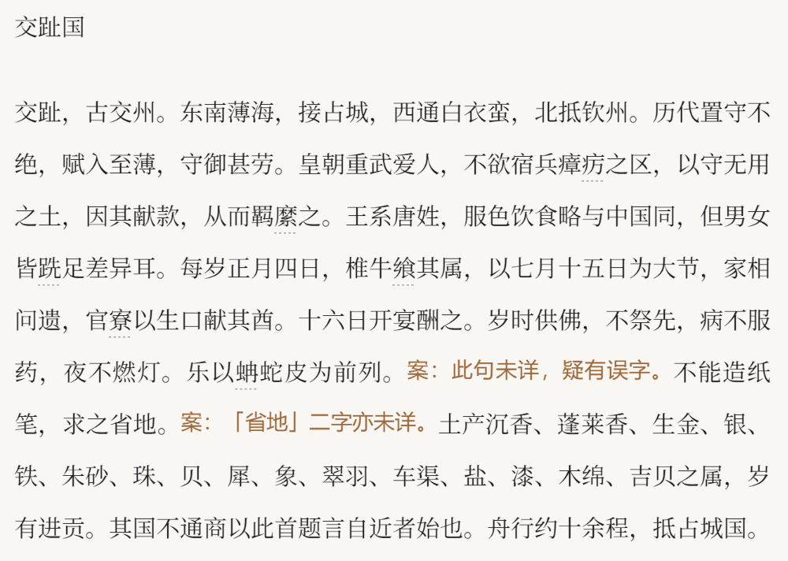
Part1:The story I want to share with you
Part1: What is my source? Why did I choose it?
Exploration of the East During the Western Age of Maritime Voyages
A Forgotten Narrative: China’s Exploration of Maritime History

Slide 4
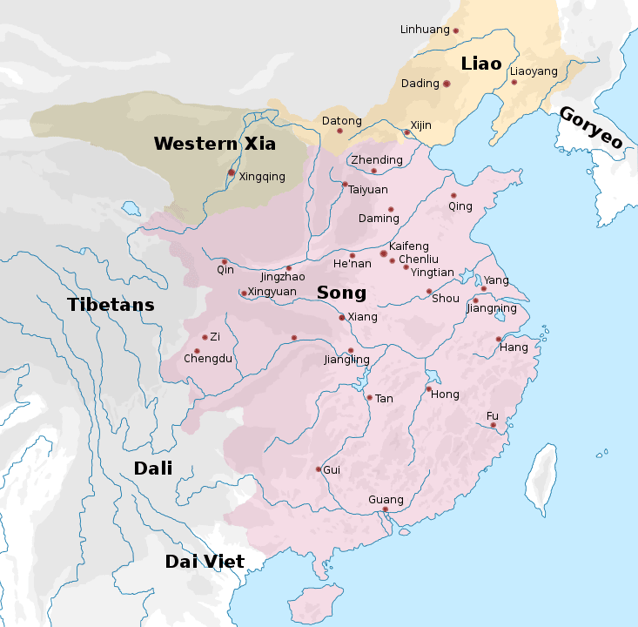
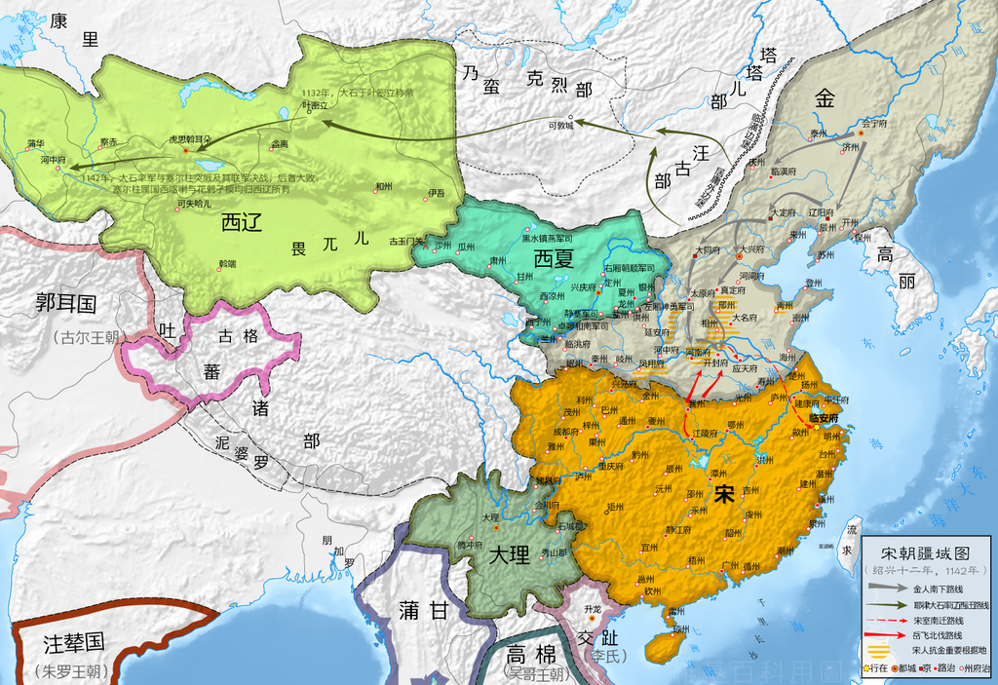
Song China: Emergence of Maritime Power and Complex Transnational Network
Part1: What is my source? Why did I choose it?
Northern Song (960-1127 AD)
Southern Song (1127-1279 AD)

Slide 5
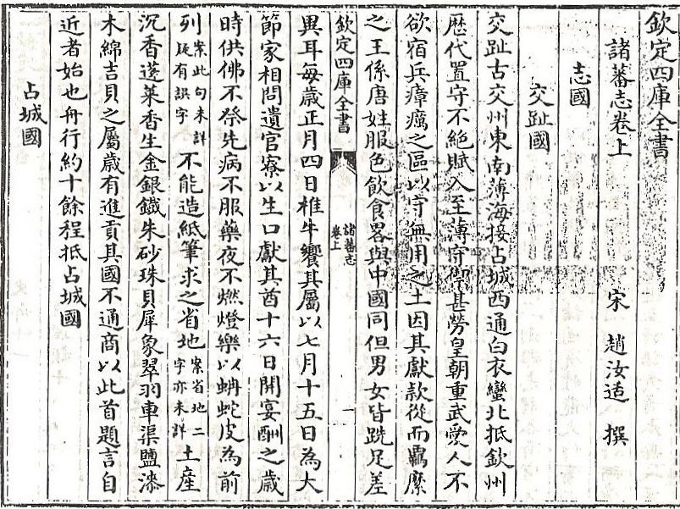
Part1: What is my source? Why did I choose it?
Zhufanzhi: A Historical Record of Foreign Lands (written by Chau Ju-Kua/Zhao Rukuo)

Slide 6
DSAM Iterations
Iteration 1: Learning primary source; Finding potential methods and tools;
OpenCC for chracters conversion
Iteration 2: Word segmentation; Realizing necessity of constructing
Stop-word list and topic dictionaries;
Jiayan (word segmentation) and Panda (word frequency) packages
Iteration 3: Tokenization of place names; High-frequency analysis;
Place name co-occurrence analysis; Social network analysis;
MARKUS platform; Gephi software
Iteration 4: Considering the Public-facing story; sharing my future plan

Slide 7
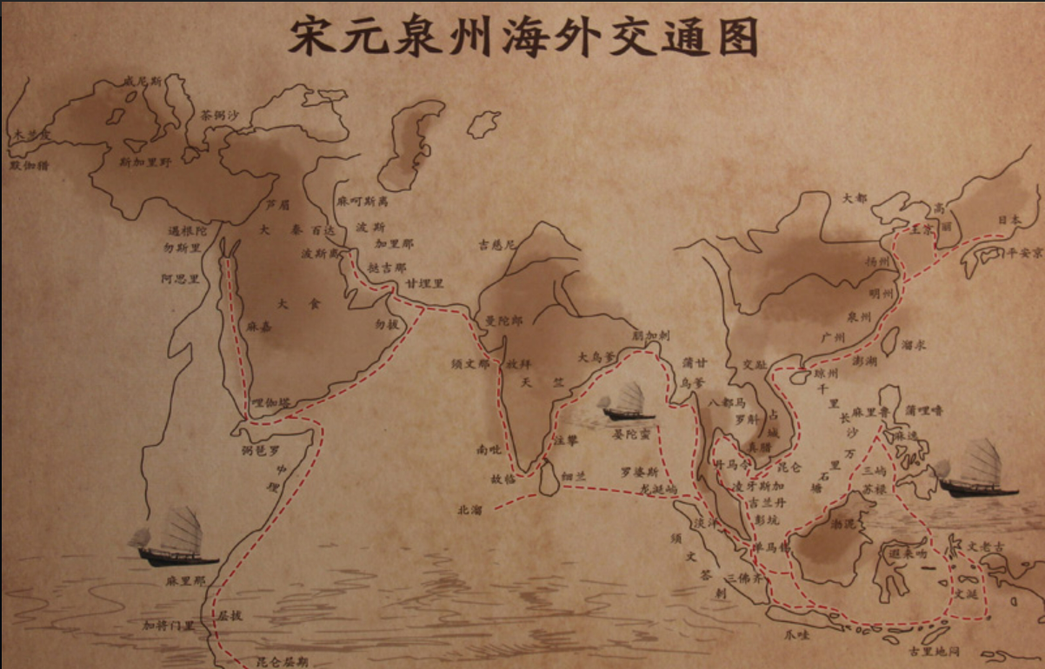
Place Names Analysis in Zhufanzhi
Part1: What is my source? Why did I choose it?
Medieval Place | Modern name | Frequency
大食 (the Islamic world) | Arab countries | 63
三佛齐 (Srivijaya) | Sumatra | 38
中国 (China) | China | 37
占城 (Champa) | Central and Southern Vietnam | 30
真腊 (the Khmer Empire) | Kambuja | 27
阇婆 (Java) | Java | 24
泉州 (Quanzhou) | Qunzhou | 21
南毗 (Kodungallur) | Kerala | 11
海南 (Hainan) | Hainan | 10
万安 (Wan'an Prefecture) | Wanning | 10
渤泥 (Borneo) | Kalimantan Island | 9
大秦 (the Roman/Byzantine empire) | Near East (Syria) | 8
麻逸 (Mindoro or Bay) | Philippines | 8
吉阳 (Jiyang) | Sanya | 8
交趾 (Dai Viet) | Northern Vietnam | 7

Slide 8
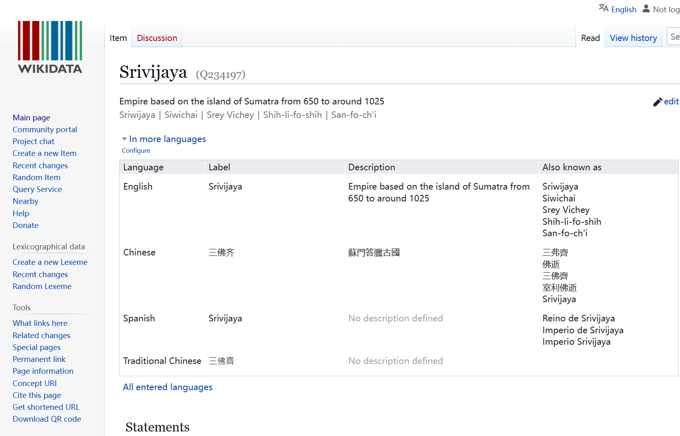
Part1: What is my source? Why did I choose it?
A Example of Place Name Information onWikidata

Slide 9
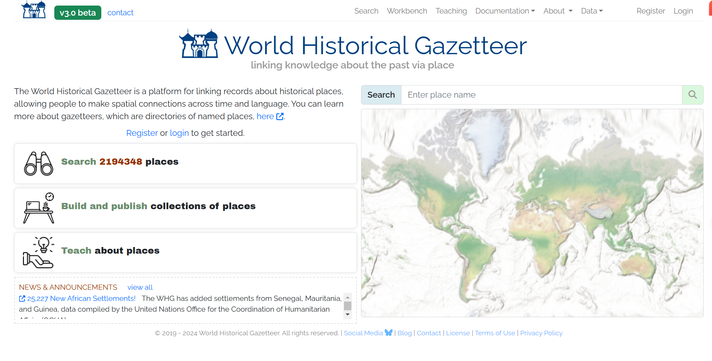
Part1: What is my source? Why did I choose it?
Exploring Historical Places with the World Historical Gazetteer

Slide 10
Place Name | Degree Centrality Rank | Place Name | Betweeness Centrality Rank
大食 | 1 | 大食 | 1
阇婆 | 2 | 占城 | 2
三佛齐 | 3 | 海南 | 3
占城 | 4 | 真腊 | 4
南毗 | 5 | 三佛齐 | 5
Place Name | Closness Centrality Rank | Place Name | Eigenvector Centrality Rank
大食 | 1 | 大食 | 1
泉州 | 2 | 三佛齐 | 2
三佛齐 | 3 | 阇婆 | 3
中国 | 4 | 占城 | 4
占城 | 5 | 泉州 | 5
Place Name | Degree Centrality Rank | Place Name | Betweeness Centrality Rank
the Islamic world (Arab countries) | 1 | the Islamic world (Arab countries) | 1
Java | 2 | Champa (Central and Southern Vietnam) | 2
Srivijaya (Sumatra) | 3 | Hainan | 3
Champa (Central and Southern Vietnam) | 4 | the Khmer Empire (Kambuja) | 4
Kodungallur (Kerala) | 5 | Srivijaya (Sumatra) | 5
Place Name | Closness Centrality Rank | Place Name | Eigenvector Centrality Rank
the Islamic world (Arab countries) | 1 | the Islamic world (Arab countries) | 1
Quanzhou | 2 | Srivijaya (Sumatra) | 2
Srivijaya (Sumatra) | 3 | Java | 3
China | 4 | Champa (Central and Southern Vietnam) | 4
Champa (Central and Southern Vietnam) | 5 | Quanzhou | 5
Part1: What is my source? Why did I choose it?
The Origital Table Exported From Gephi

Slide 11
Degree Centrality
Part1: What is my source? Why did I choose it?

Slide 12
Closness Centrality
Part1: What is my source? Why did I choose it?

Slide 13
Betweeness Centrality
Part1: What is my source? Why did I choose it?

Slide 14
Eigenvector Centrality
Part1: What is my source? Why did I choose it?

Slide 15
Place Name | Degree Centrality Rank | Place Name | Betweeness Centrality Rank
大食 | 1 | 大食 | 1
阇婆 | 2 | 占城 | 2
三佛齐 | 3 | 海南 | 3
占城 | 4 | 真腊 | 4
南毗 | 5 | 三佛齐 | 5
Place Name | Closness Centrality Rank | Place Name | Eigenvector Centrality Rank
大食 | 1 | 大食 | 1
泉州 | 2 | 三佛齐 | 2
三佛齐 | 3 | 阇婆 | 3
中国 | 4 | 占城 | 4
占城 | 5 | 泉州 | 5
Place Name | Degree Centrality Rank | Place Name | Betweeness Centrality Rank
the Islamic world (Arab countries) | 1 | the Islamic world (Arab countries) | 1
Java | 2 | Champa (Central and Southern Vietnam) | 2
Srivijaya (Sumatra) | 3 | Hainan | 3
Champa (Central and Southern Vietnam) | 4 | the Khmer Empire (Kambuja) | 4
Kodungallur (Kerala) | 5 | Srivijaya (Sumatra) | 5
Place Name | Closness Centrality Rank | Place Name | Eigenvector Centrality Rank
the Islamic world (Arab countries) | 1 | the Islamic world (Arab countries) | 1
Quanzhou | 2 | Srivijaya (Sumatra) | 2
Srivijaya (Sumatra) | 3 | Java | 3
China | 4 | Champa (Central and Southern Vietnam) | 4
Champa (Central and Southern Vietnam) | 5 | Quanzhou | 5
Part1: What is my source? Why did I choose it?
The Origital Table Exported From Gephi

Slide 16
Part1: What is my source? Why did I choose it?
Future Plans?

Slide 17
Part1: What is my source? Why did I choose it?
Celebration!

